Slide 1
Technical assistance for the elaboration of the future Interreg Programme Romania-Hungary 2021-2027 (including the realisation of SEA)
Consultation workshop for elaboration of the Territorial Analysis of the Cross-border area

Slide 2
Event programme
Openings
General presentation
The Territorial Analysis: results, questions and answers
Policy analysis and lessons learnt
Conclusions and the way forward

Slide 3
Introduction on the next programming period 2021-2027 strategic framework

Slide 4
The EU strategic framework for 2021-2027
5 Policy Objectives (POs)
A smarter Europe - innovative and smart economic transformation.
A greener, low-carbon Europe.
A more connected Europe - mobility and regional ICT connectivity.
A more social Europe - implementing the European Pillar of Social Rights.
Europe closer to citizens – sustainable and integrated development of urban, rural and coastal areas through local initiatives.

Slide 5
The EU strategic framework for 2021-2027
Important: the legal framework is still in the draft phase and will be finalized after a trialogue.
In this current situation:
60% of the programme resources should be allocated on a maximum of 3 policy objectives. (Pending whether PO2 and PO4 will be mandatory.)
Part of the resources should / can be allocated on the two Interreg-specific objectives up to 10% or 15% of the resources.
The two Interreg specific objectives (ISO) are:
ISO 1. “Better Interreg / Cooperation Governance” and
ISO 2. "A safer Europe".

Slide 6
The EU strategic framework for 2021-2027
Increased importance of complementarities and synergy between different EU programmes and funds, as well as a growing accent on the contribution of the ETC to macro-region strategies;
Possibility to allocate funds to the specific ETC objective to strengthen the institutionalisation of cross-border cooperation;
Possibility to explore new cooperation solutions.

Slide 7
The EU strategic framework for 2021-2027
accent on the need to analyse and prepare recommendations regarding legal barriers to cross-border cooperation, as well as other transversal issues (also making full use of existing studies and tools created under ESPON and other research activities dealing with territorial analysis).

Slide 8
Territorial Analysis in a nutshell

Slide 9
Approach for the Territorial Analysis
Desk analysis: definition of common indicator database for the cooperation area (120 primary indicators and datasets at NUTS 3 and LAU 2 level)
Data sources for quantitative analysis: European (Eurostat, Copernicus, EEA, etc.) and national official sources (INS, TEIR and KSH).
Additional data: qualitative and quantitative information at higher territorial scales, national strategies, regional development plans, ESPON studies
Critical: enriching the findings of the TA by exchanges and consultations with the key institutional stakeholders in the region

Slide 10
Missing or not comparable data at NUTS 3 or city level:
Related to social indicators (i.e. commuting rates, NEETs, marginalised communities, and others);
Related to energy and environmental infrastructures (i.e. energy consumption per capita, municipal waste, density use of renewable energy, potential for renewable energy production and others);
Related to the urban environment (i.e. dynamics of built-up areas, living space per person / overcrowding rate, social housing and others)

Slide 11
Cross-cutting findings (demography and human settlements)
Strengths | Weaknesses
In the European context, the PA has a relatively younger population | With the exception of Timiș county, the population has declined throughout the PA
Generally positive trends in human capital development, with raising life expectancy, lowering rates of social exclusion and unemployment, and a well-developed higher education network | Romanian regions have a larger share of rural settlements, whilst Hungarian regions have a higher number of overall settlements, which implies in both case a certain fragmentation of the settlement structure
Major cities like Arad, Oradea, Satu Mare, Debrecen, Békéscsaba, Szeged are very close to the border (20-40km). | There is a general process of population aging in the PA, as shown by increasing trend in dependency ratio
Timișoara and Debrecen are two strong major urban centers for each side of the PA with complex functions and a large variety of public functions | Different degree of public functions distribution (especially health, education, touristic infrastructure), except major urban centres.

Slide 12
Cross-cutting findings (demography and human settlements)
Opportunities | Threats
The density of urban centres and subcentres network provides multiple public services functions that can work as a functional cross-border system | Given the high density of public functions and facilities that the main urban centres have, the `cold spots` / disadvantaged areas situation can get worse over time (due to external migration, migration to the cities proximity, etc)
Positive population growth trends (up to 20% increase between 2009-2018) are spatially distributed predominantly along the border between Hungary and Romania, which is a positive indication for cross-border functional integration | Continuing negative net emigration trend, due to low attractiveness (i.e. in terms of salaries and economic opportunities) of the PA in European context
Increased investment in social and health services adapted to the needs of the population | Limited investment capacities of minor public administrations
Increased investments in the educational offer in support of youth retainment in the PA | Lack of information related to cross-border labour market skills’ needs

Slide 14
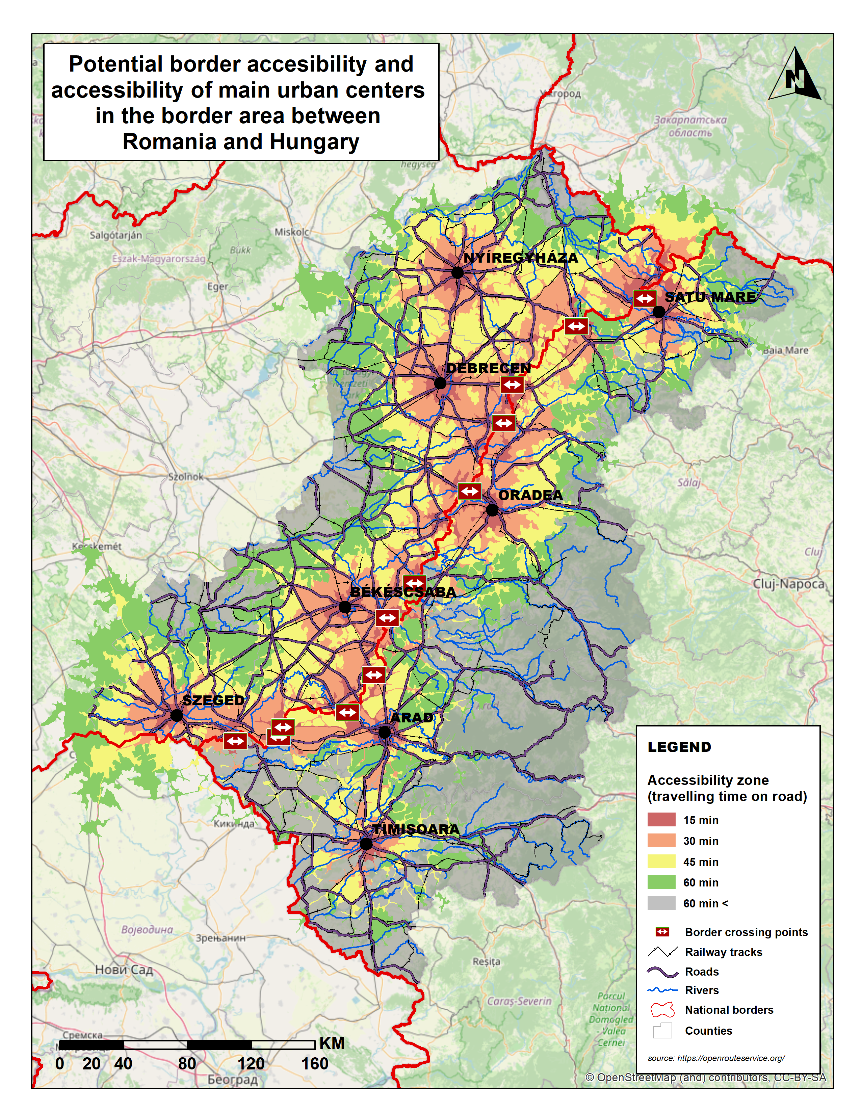
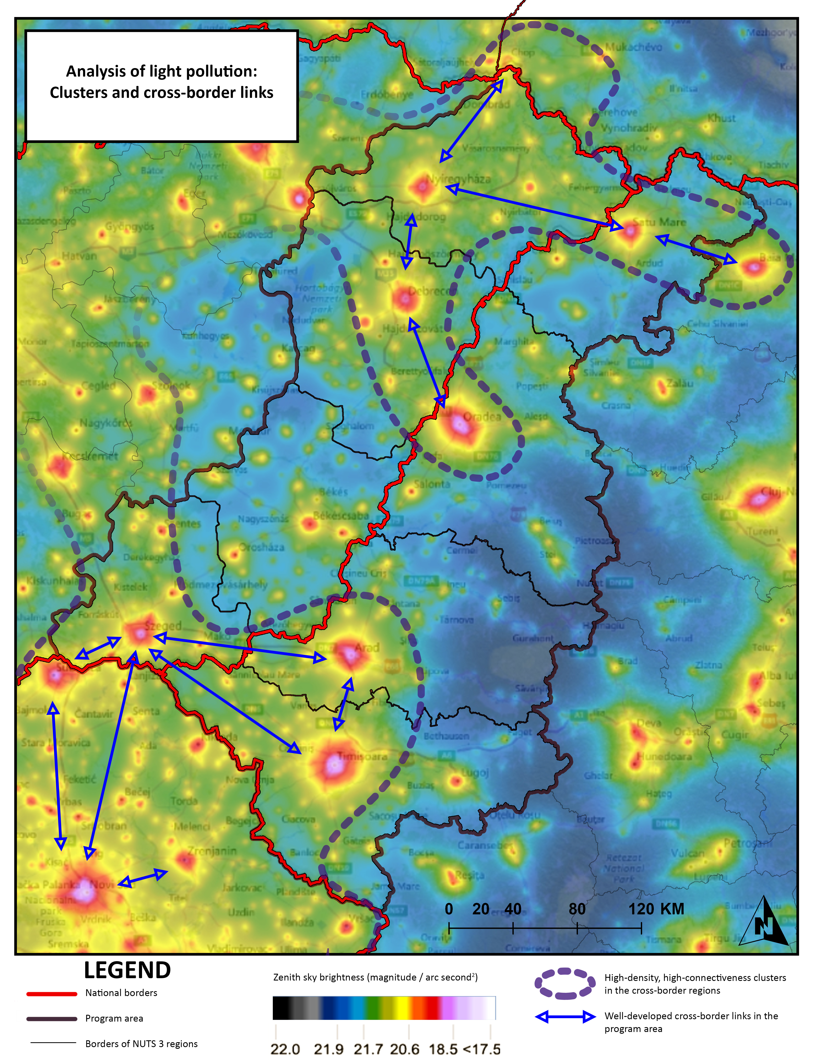

Slide 16
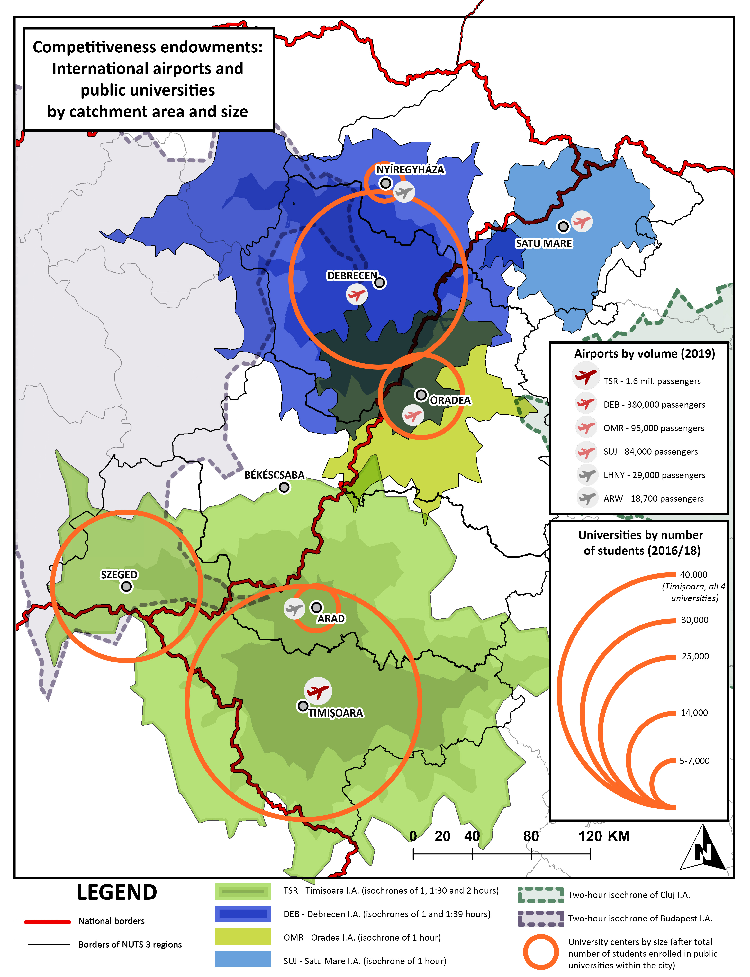
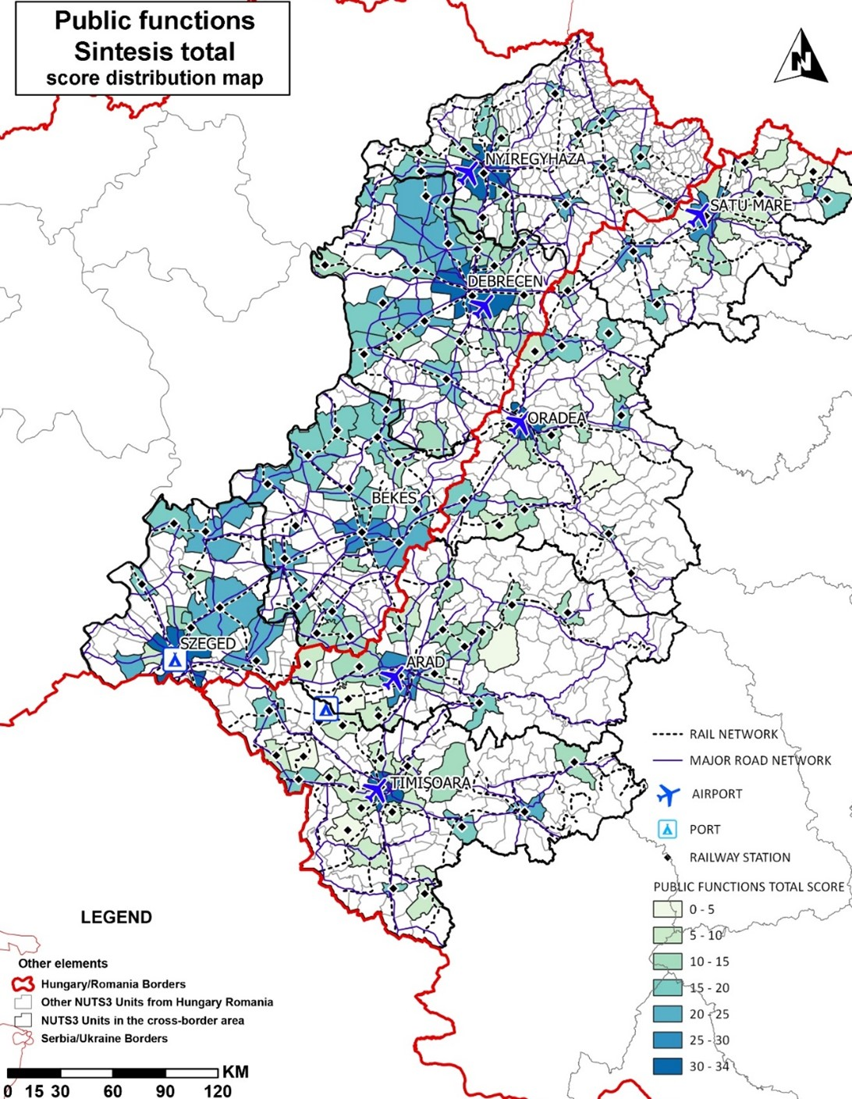

Slide 17
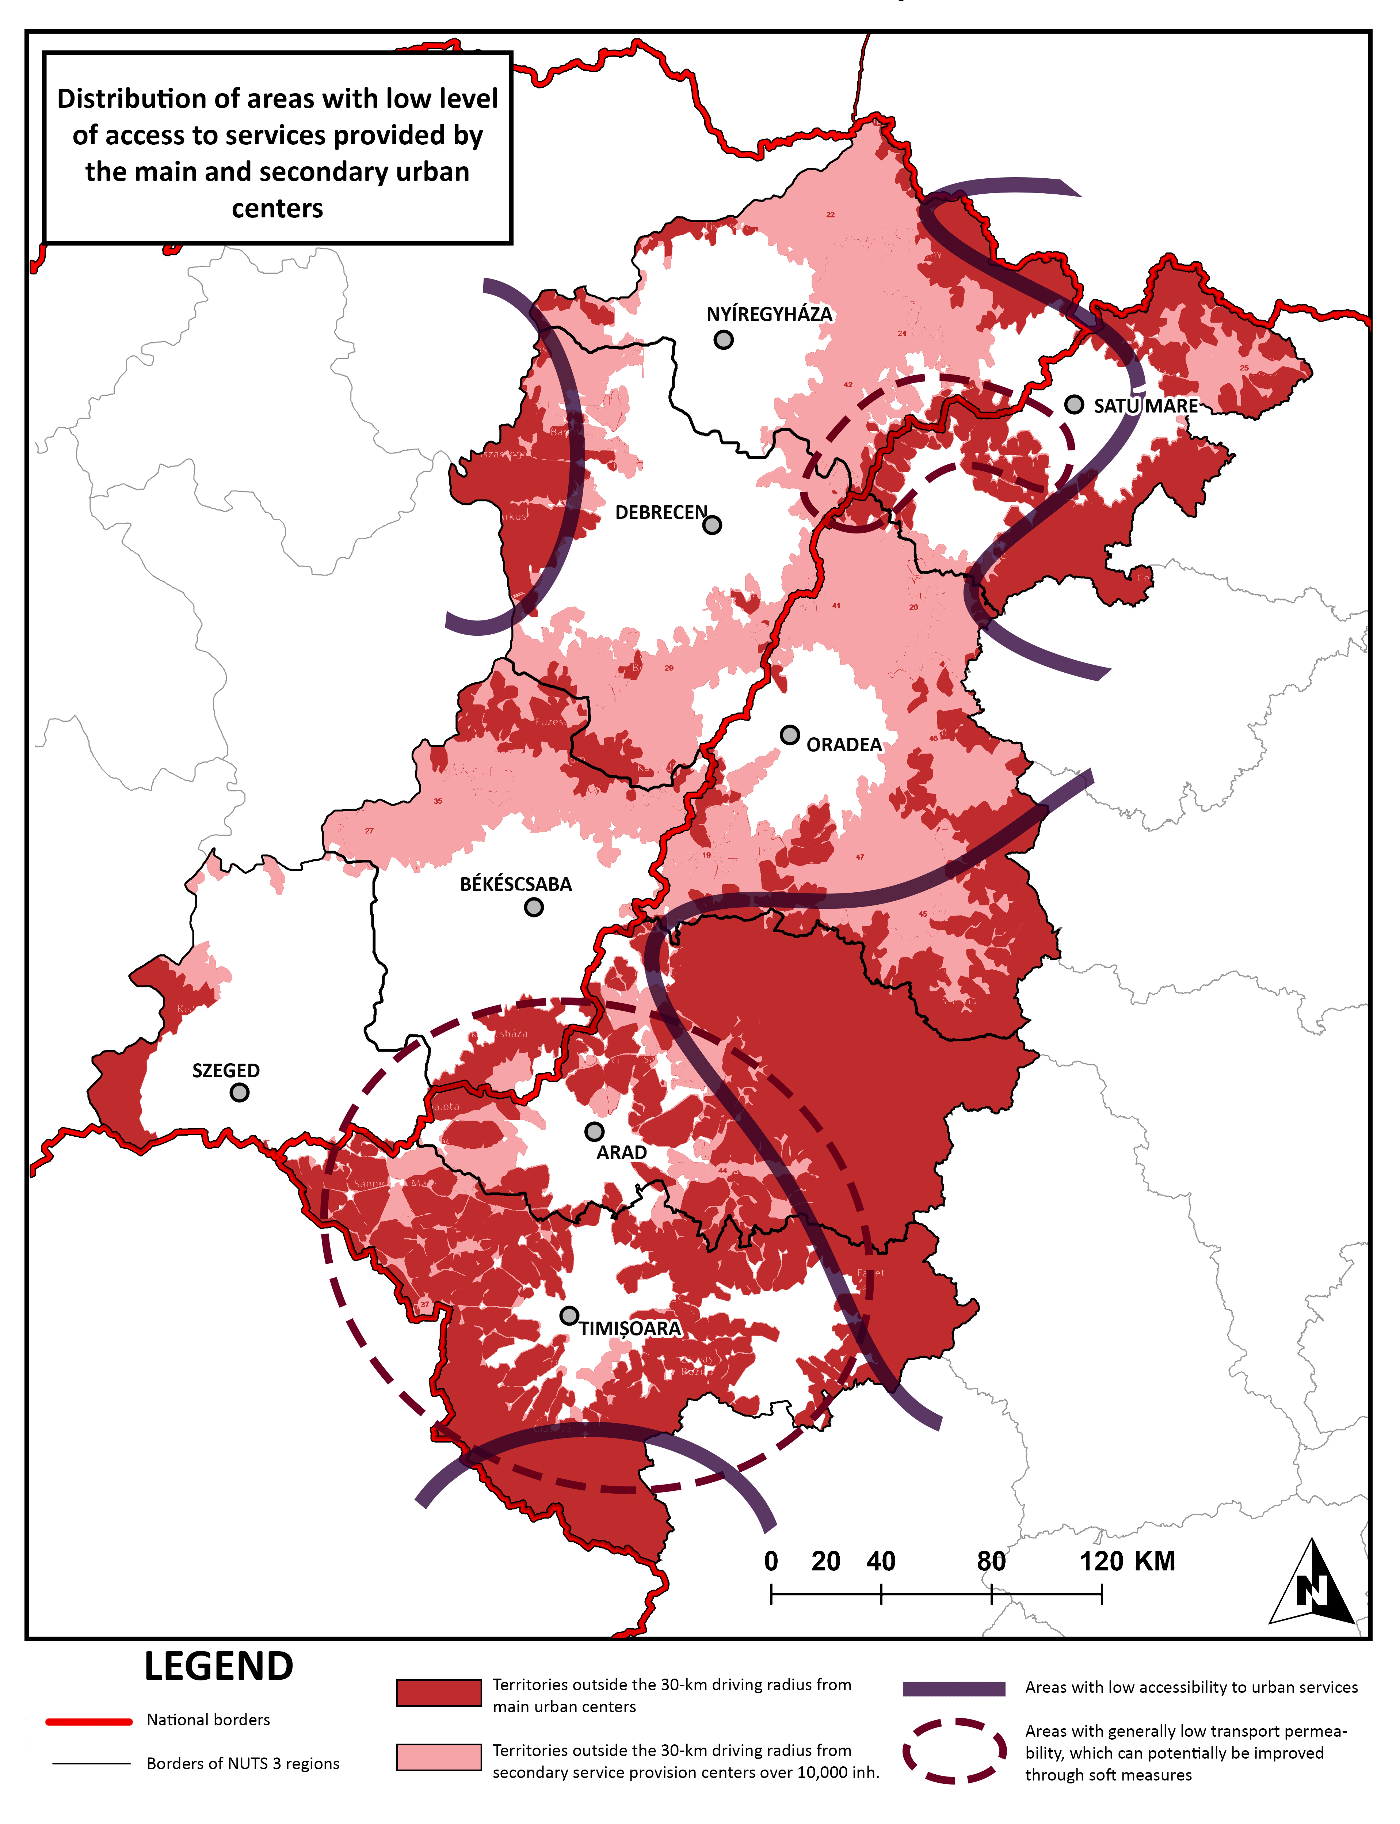
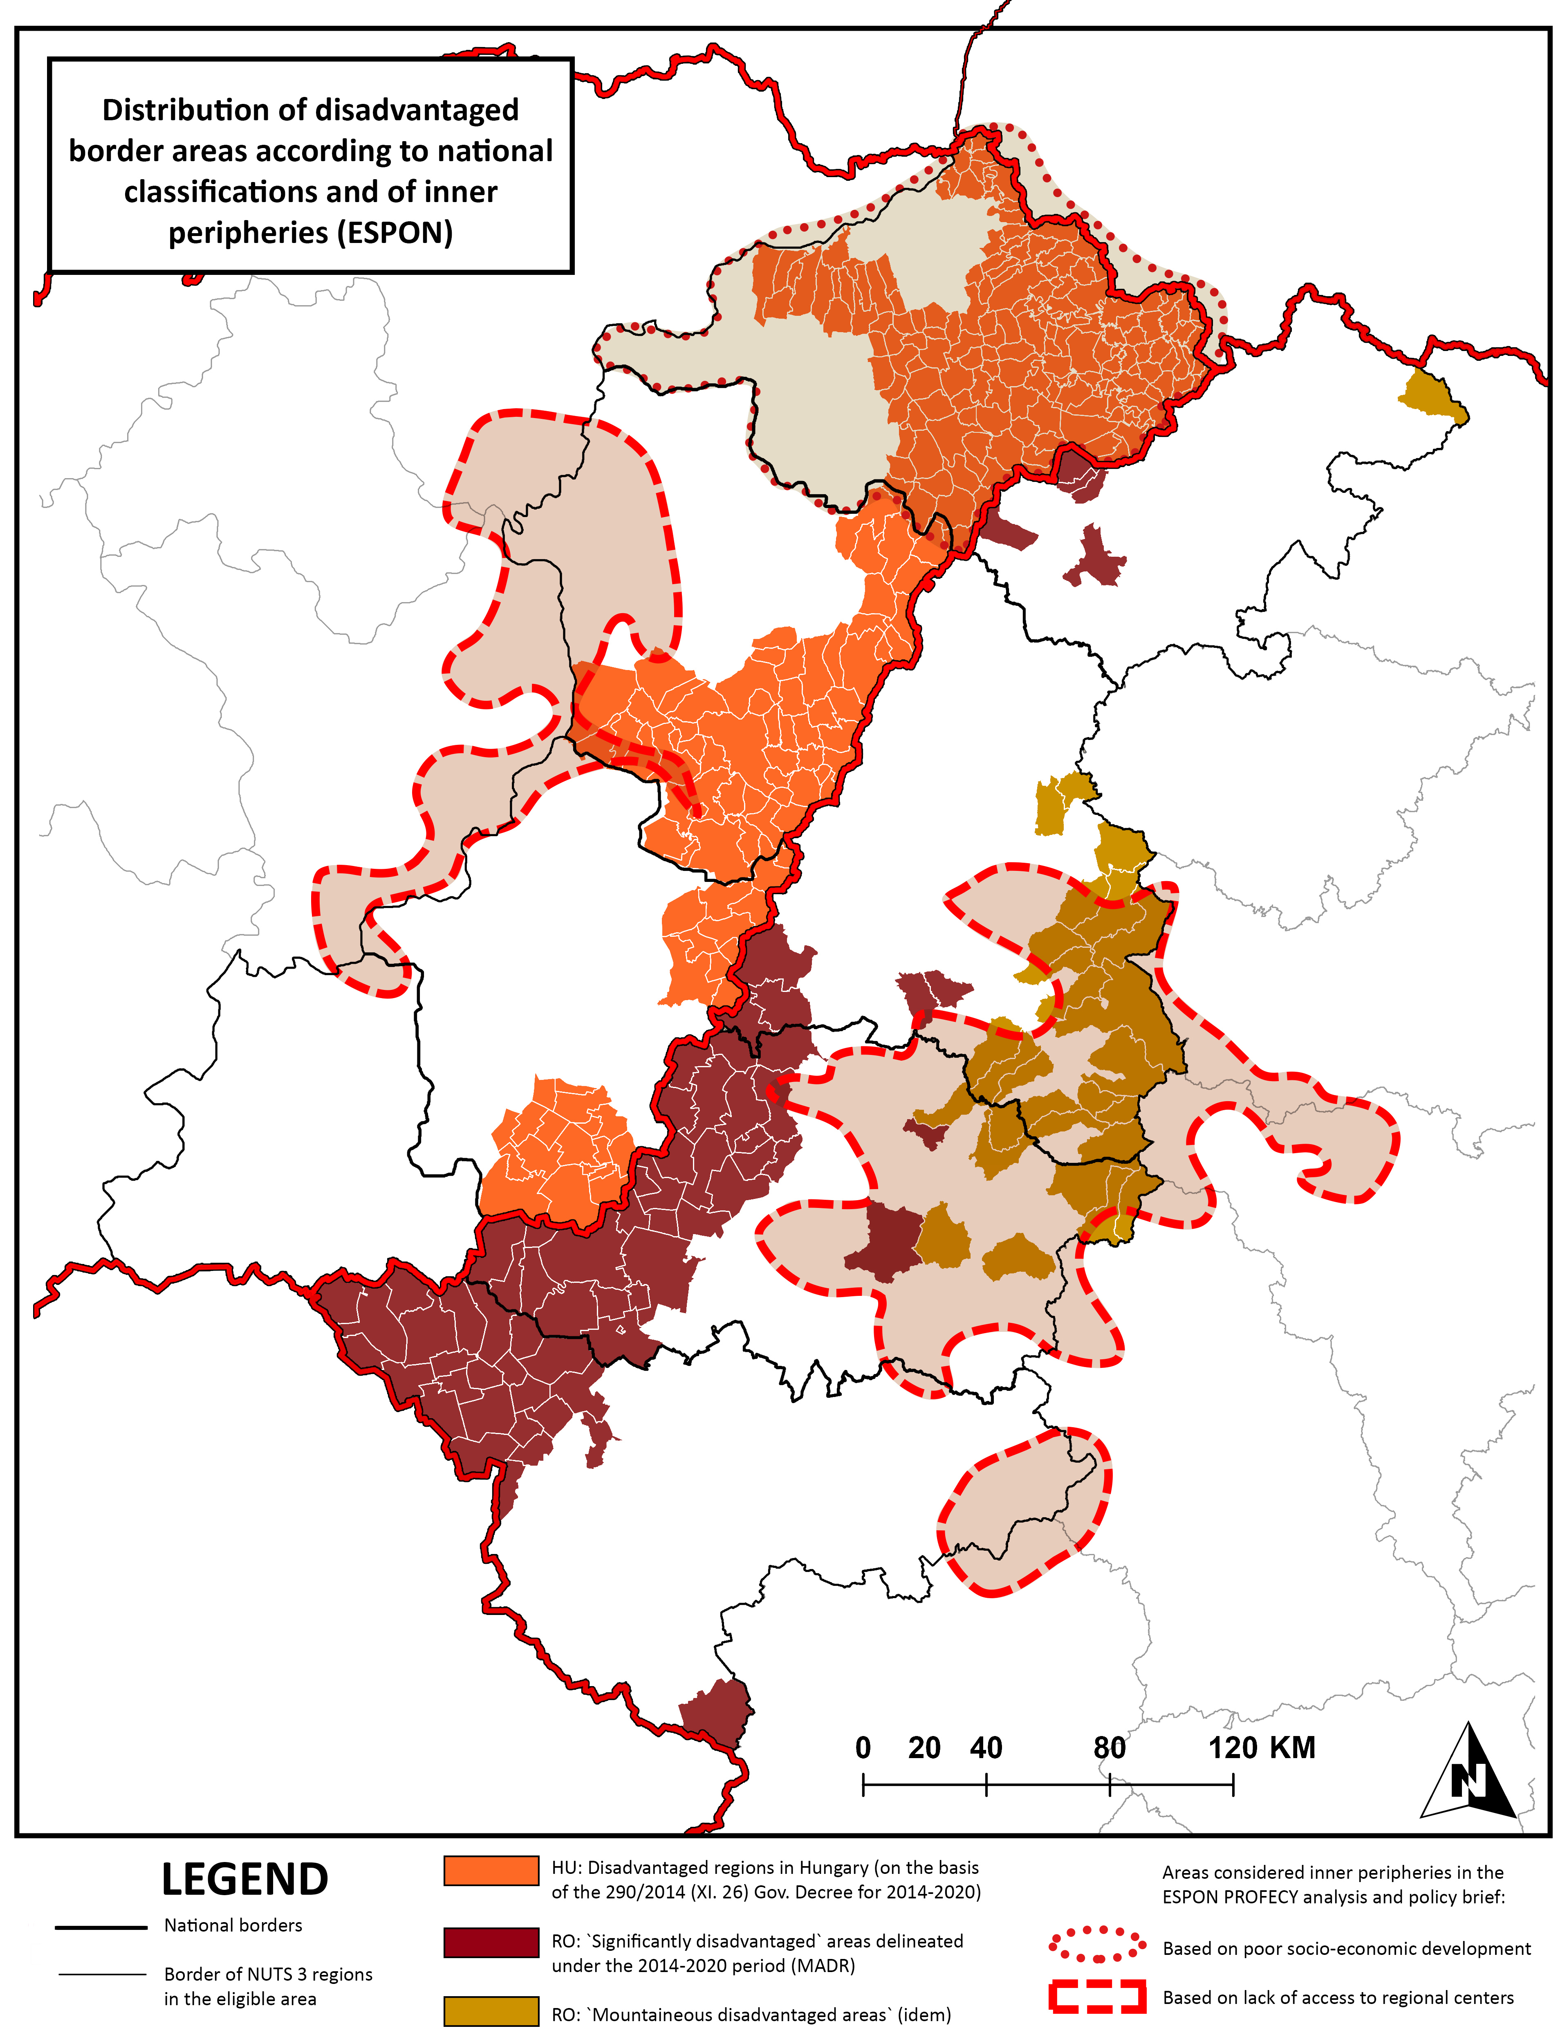

Slide 18
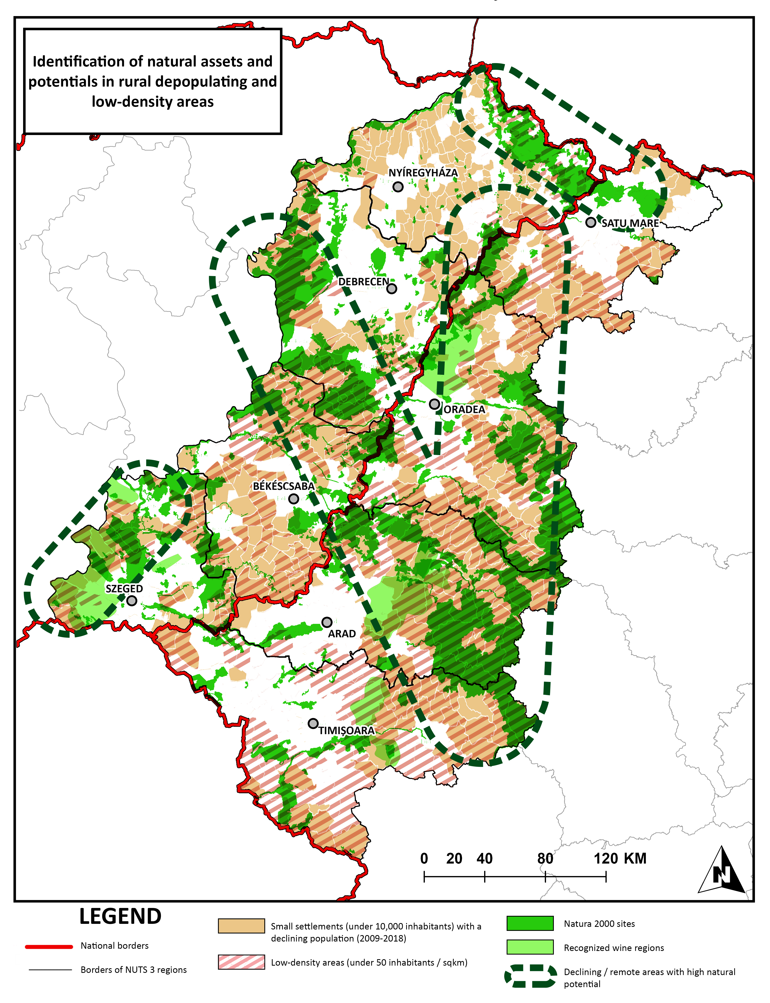

Slide 19
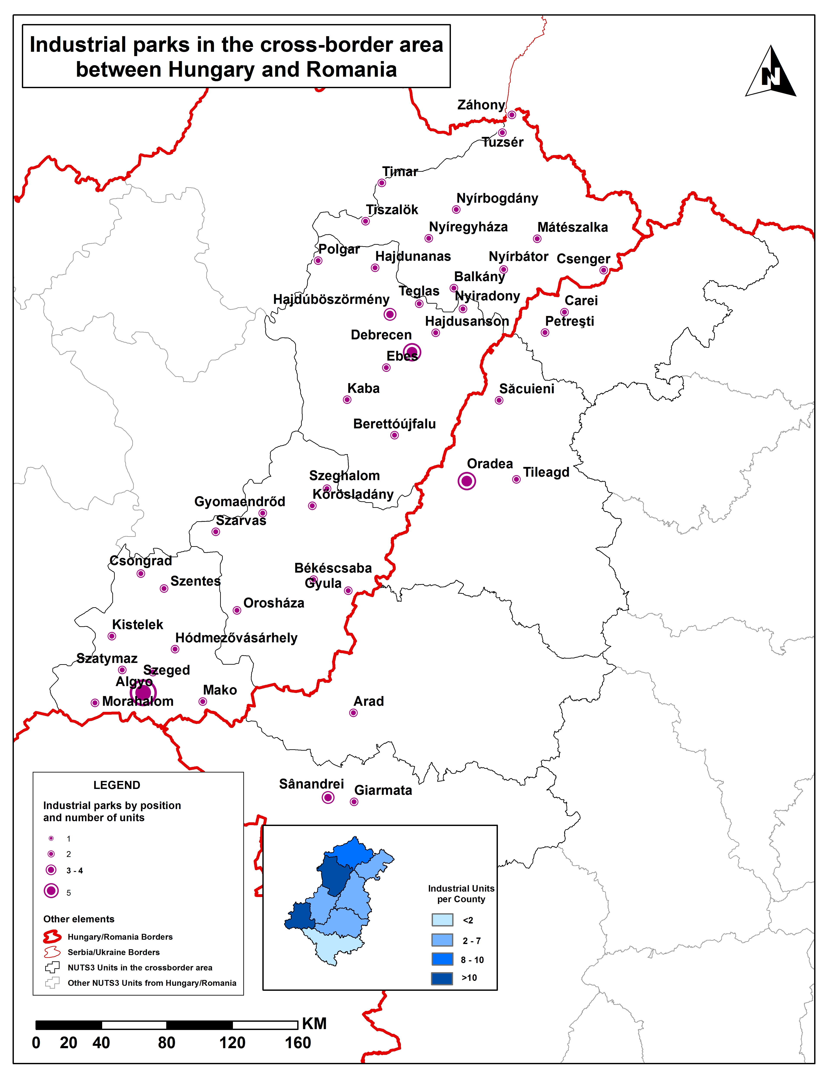

Slide 20
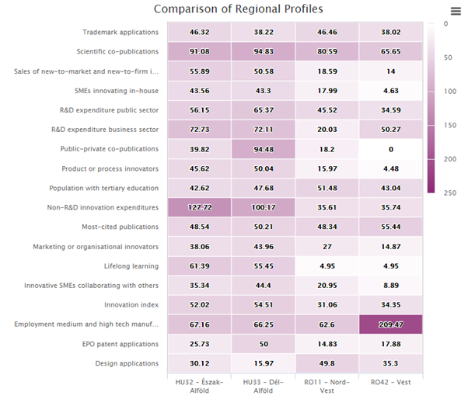

Slide 21
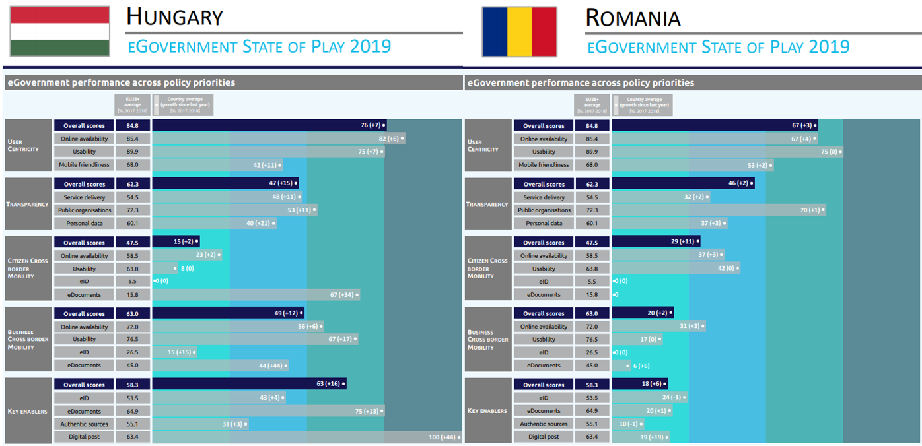

Slide 22
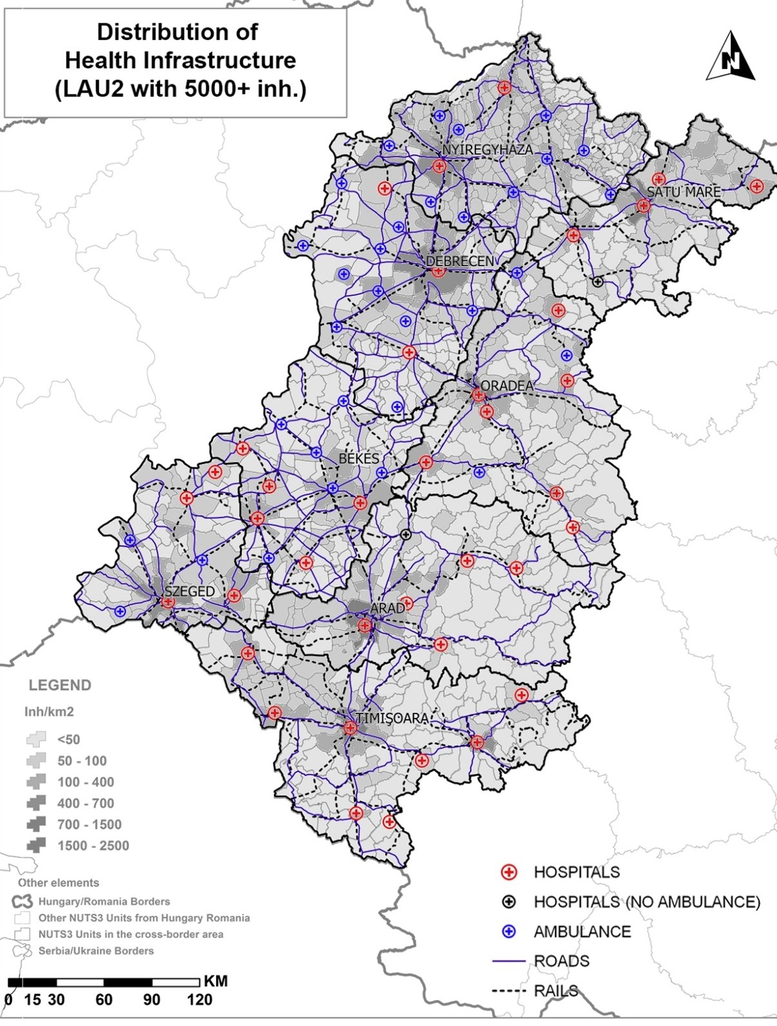
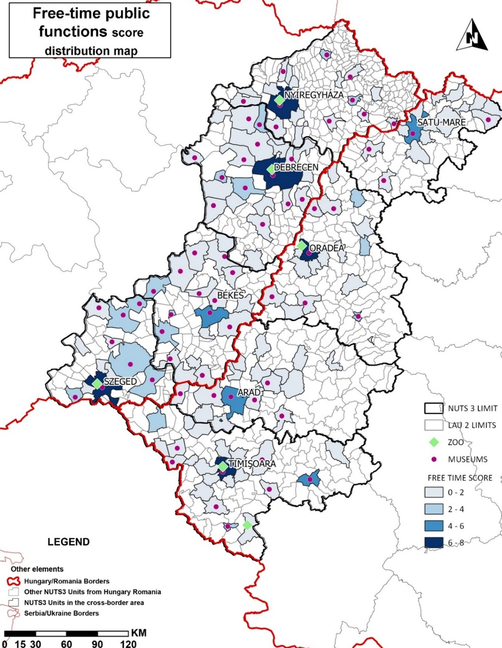

Slide 23
Findings relevant for Policy Objective 1 “A smarter Europe”
Strengths | Weaknesses
The programme area has managed to spring back from the global economic crisis, having a level of growth far above the European average | Loss of human capital to other EU countries is affecting the economic development – even if there is a decrease in the migration values, the number of emigrants is higher than the number of immigrants, especially in the Romanian region
The PA two most economically developed regions are: Timiș with a major share of the Romanian PA GDP - 46.4%; Hajdú-Bihar with a major share of Hungarian PA GDP - 31.95% | The economic sectors are lacking competitiveness including due to low degree of innovation. Economic performance imbalance in the region: less national GDP share than 2009
Significant growth of productivity in the ICT sector in the programme area (+41.5% increase between 2009 and 2017) | Although there is an increase in the productivity level (euro/person) in both countries for agriculture, industry and trade and retail sectors, the PA labour productivity is far behind European average.
Thanks to high volume of EU funds investments, the border regions have developed production and service delivery capacities, which have led to a better integration in the EU production chains. | Despite its new manufacturing and ICT clusters, the region is dominated by low-level technologies at the lower end of production chains, scoring low in business sophistication.

Slide 24
Findings relevant for Policy Objective 1 “A smarter Europe”
Opportunities | Threats
Investments in RDI and other investments from ERDF and other EU and national mainstream programmes | Covid-19 pandemic
Increased attractiveness for foreign direct investment (FDI) . | Decreasing capacity of the education system and increasing brain drain have the consequence of reducing the capacity of the economic system to grow towards more knowledge-intensive economic activities
There are new economic clusters (ICT) emerging on both sides of the border (especially in Nyíregyháza, Debrecen and Oradea) | Growing internal disparities in the capacity to attract FDI and other funds, in view to support the economic recovery
Concentrating joint cross-border interventions in the fields of smart economy and economic areas of common interest on both sides of the border. | Growing internal disparities and loss of potential to invest in RDI activities.

Slide 25
Findings relevant for Policy Objective 2 “A greener Europe”
Strengths | Weaknesses
A favourable topography to cross-border linkages, lacking natural barriers („green border”), endowed with rich natural heritage (40-60% coverage with Natura 2000 sites of the PA counties) | Land abandonment, deforestation and ineffective management of natural resources
Rich hydrographic elements in the region on the East-West direction providing common cross-border riparian areas with diversified and valuable ecosystems | Significant flood risk and other natural hazards (e.g earthquakes,climate, etc) in the PA, especially on the Mureș, Crișul Alb and Someș rivers
The entire PA has a dense distribution of thermal baths and balneary facilities and generally a geothermal easily exploitable natural resources | Low use of renewable energies and no official statistical data of use of solar energy, wind energy etc...
High potential for renewable energies: hydro power and solar to a degree, but also geothermal energy, with all four Hungarian counties and the Romanian PA territory being covered by hot sedimentary aquifers | Existence of urban waste water treatment plants with only secondary treatment, especially in the Romanian region

Slide 26
Findings relevant for Policy Objective 2 “A greener Europe”
Opportunities | Threats
Possibility to obtain biomass energy from forest products and forests residues, crops and organic wastes, regions Hajdú-Bihar, Oradea and Arad having the highest potential. Opportunity to introduce demonstrated new technologies and nature-based solutions | Fragmentation and differences in the legislation and institutional settings governing the management of protected areas; lack of harmonisation across the PA with respect to data curation, and significant data gaps.
Potential for cross-border cooperation in the subregions of Timiș – Csongrád-Csanád and Bihor – Hajdu-Bihar - Szabolcs-Szatmár-Bereg based on the similar high renewable resources potential profiles | Flood risks on the course of main rivers and other natural hazards (e.g earthquakes,climate, etc) involve potential exposure to environmental disasters, due to proximity of hazard zones
Cooperation in the field of waste management, in support of improved recycling practices
Valorising and protecting the common natural heritage, through joint actions for reforestation

Slide 27
Findings relevant for Policy Objective 3 “A more connected Europe”
Strengths | Weaknesses
The cross-border region is crossed by TEN-T European corridors | Generally lower-than-average transport performance (with the exception of Csongrád) and road accessibility, both at cross-border level and within several counties included in the PA.
The presence of Timișoara Airport as the largest airport in the region and the third-largest in Romania | Very low rail connectivity, which makes rail transport unsuitable for cross-border commuting
The traffic volume at the border crossing points is increasing significantly from both sides (Romania cross-border area has the highest values – for example 12540598 vs 3459676 in 2019). | Public transportation infrastructure between major cities is underdeveloped, with no direct train route between Szeged-Timișoara, Nyíregyháza – Satu Mare
 | Intra-regional disparities in ICT access, and a significant overall digital divide compared to the EU-27 average

Slide 28
Findings relevant for Policy Objective 3 “A more connected Europe”
Opportunities | Threats
Implementation of planned highway projects in Romania (A9, finalisation of A3 Oradea - Cluj-Napoca, Someș Expres) and Hungary (M44 Békéscsaba - Gyula / Romania, M4, M49) | Lack of comparable data on the state of coverage and performance of urban infrastructures, but also of in what regards cross-border mobility for certain border crossings points
The growing cross-border traffic can potentially sustain railroad investment. Recent priority projects on the European Corridors for high-speed rail connecting Budapest with Timișoara, Brașov, Bucharest and Constanța may revive interest in rail transport and provide a viable transport option in the medium term. | Underdevelopment of ICT infrastructure specifically in relation to vital services and applications can represent a significant weakness in dealing with threats such as the Covid-19 pandemic (e.g.. from tracking the geographical spread of the pandemic to enabling digital transition in education and healthcare provision with minimal disruption)
 | Barriers to effective connection RO-HU and cross-border exchanges, due to effects of Schengen Agreement

Slide 29
Findings relevant for Policy Objective 4 “A more social Europe”
Strengths | Weaknesses
Good access to healthcare in the southern part of the programming area – Csongrád-Csanád (6.3‰ doctor per inhabitant) and Timiș (6.2‰ medics per inhabitant). | PA is still lagging behind the European level in the performance for several indicators, including life expectancy at birth and infant mortality, recording significant intra-regional disparities as well
The cross-border values for total hospital beds per 100 thousands inhabitants are above the European 27 average (537 European average versus 693 beds per 100000 inhabitants average for the PA, in 2018). | Disparities in the distribution of health ambulatories in the PA, with concentration of services and infrastructures near urban centres, especially on the Romanian side of the border.
Regarding tertiary education, the PA has a well-developed infrastructure, with Timișoara, Debrecen and Szeged representing established university centres | There is a disparity between Romania and Hungary in what concerns the average number of pupils to a school teacher and a general decrease in the PA in the number of graduates for ISCED 3 and 5 and above. Low skilled workers are much exposed to long term unemployment
The number of people at risk of poverty exclusion has significantly dropped in the last 5 years | Although decreasing, there is still a percentage of 23.3% of people at risk of poverty or social exclusion in Hungary, and 44.3% in Romania. Both rates are still higher than the national averages.

Slide 30
Findings relevant for Policy Objective 4 “A more social Europe”
Opportunities | Threats
Developing health cross-border infrastructure, optimising the distance in cases of emergencies | Unforeseen global events such as the Covid-19 pandemic can have a significantly negative impact on the region’s vulnerable health infrastructure
The development of joint re-qualification educational programmes (including for the health professionals), transnational mobility programmes and early leaver mitigation strategies | Sub-regional structural vulnerabilities of the labour market (i.e. in the northern areas of the region)
Promoting socio-sanitary policies (including home care and personalised health services) addressing population aging may contribute to the increase and differentiation of public services | Limited enrolment rates of students in tertiary education may hinder the capacity of the regional systems to tackle highly qualified skills’ needs in the PA
Extending cooperation and exchange of knowledge from stronger urban poles towards other cities may support increased quality and the diversification of education and job opportunities

Slide 31
Findings relevant for Policy Objective 5 “A Europe closer to citizens”
Strengths | Weaknesses
Similarity in the implementation of vertical governance coordination, with the use of public authority associations and federations (such as national associations of municipalities and cities), which are endowed with levers to become involved to a large degree in promoting local development. | Relatively low capacity and activity of cross-border cooperation structures (e.g euroregions): personnel range from 5 to 1 FTE, and average yearly total expenses from 224.500 to 10.300 EUR (2011-2019).
Long history of informal cooperation, or expressed willingness for cooperation

Slide 32
Findings relevant for Policy Objective 5 “A Europe closer to citizens”
Opportunities | Threats
Strong policy support on behalf of the European Commissio to the consolidation of cross-border governance | Capacity and institutional building of cooperating structures and associations of public and private entities in a cross border context needing long time to consolidate and an adequate legal framework allowing the delegation of power to delivery public services.
Building on lessons learnt and promoting continuity with the implementation of SUD through Integrated Territorial Programmes and Integrated Urban Development Strategies in all county seats / major urban centres | Administrative and legal barriers (including sector standards and requirements) to plan and delivery joint public services in the PA.

Slide 33
Findings relevant for ISO 1 “A better Interreg governance”
Strengths | Weaknesses
Commonalities in the way the multi-level administrative structure of the two states is organized, where NUTS 3 and LAU 2 levels are the most relevant in terms of competencies for local development. | Generally high level of territorial fragmentation at administrative unit level
Both Hungary and Romania rank in the Very High EGDI Group (UN, 2020), while Romania ranks very high for e-Participation, and Hungary ranks high for the year 2019. | Quality of Government Index performance on the lower comparative scale with the rest of Europe, for all NUTS 2 regions involved
Long history of informal cooperation, or expressed willingness for cooperation | Larger rural areas (such as parts of Arad, Bihor, Hajdu-Bihar counties) may face reduced administrative capacity and/or resources for implementing cooperation

Slide 34
Findings relevant for ISO 1 “A better Interreg governance”
Opportunities | Threats
Create synergy in the region between the future Programme and other neighbour areas or EU MRS (ex: Strategy for the Danube Region), as well as with other EU funds and programmes addressing administrative capacities of local public administrations, including as regards e-government services. | Delays in the implementation of the national Digital agenda in both PA countries
Apply good practices from other CBCs, in the context of the administrative framework of the Romania-Hungary, as innovative mechanisms to reduce barriers to cooperation | Administrative and legal barriers (including sector standards and requirements) to plan and delivery joint public services in the PA.
Existence of dedicated Covid-19 information portals, e-services, tools put in place by the EC which can be used by the national and local governments in the programming area for accelerating digital transition of eGovernment services for health, education, social protection, participation, and other relevant topics. | Further waves of pandemic decreasing the volume of cross-border interactions and hindering the operation of innovative cross-border cooperation models

