Slide 1
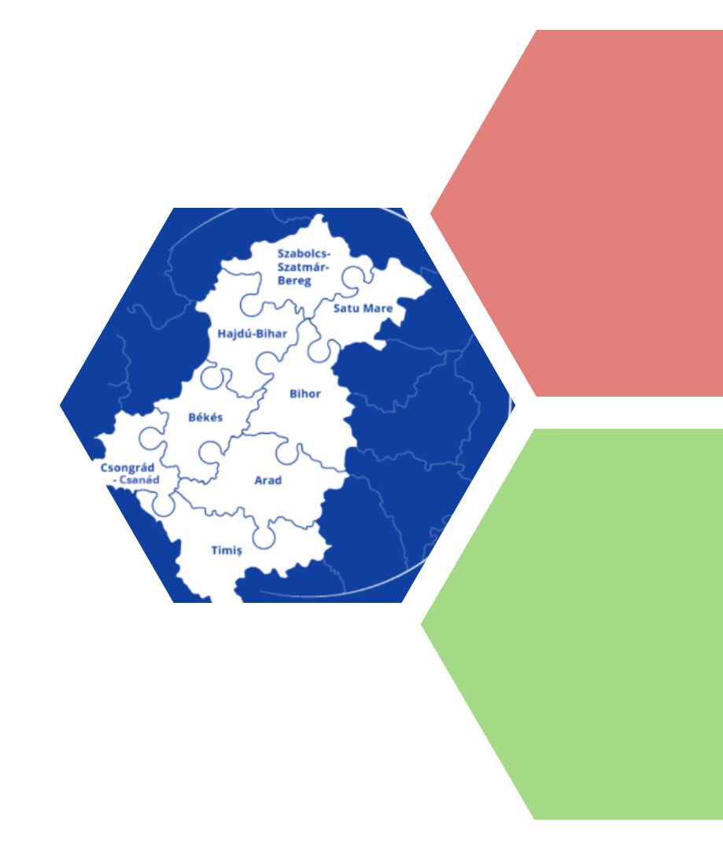
TARGETED CALL
OPERATIONS OF
STRATEGIC IMPORTANCE |OSIs
INTERREG VI-A ROMANIA-HUNGARY PROGRAMME

Slide 2
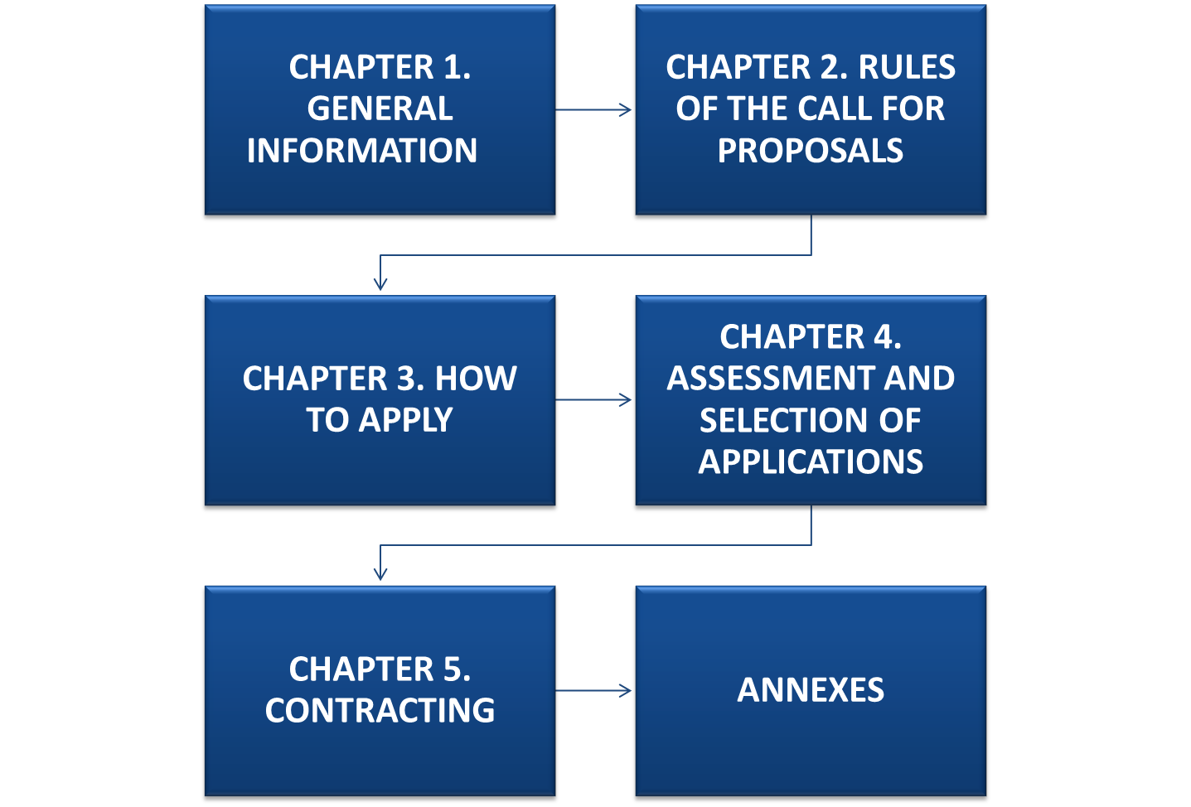
Guide for applicants
Drafted in a simplified manner;
Consulted with MC members;
Public consultation October - November 2024; ​

Slide 3
Call for OSIs basics
Procedure: Targeted call
Submission: Online via JEMS
Deadline: continuous, until December 2nd, 2024
Priorities (Ps): P1, P2 and P3
ERDF allocation for the Call € 70,376,010

Slide 4
Call for OSIs basics
Priority | Priority title | Restricted Call Allocation
P1 | Cooperation for a green and more resilient cross-border area between Romania and Hungary | 21,632,072.00
P2 | Cooperation for a more social and cohesive PA between Romania and Hungary | 42,975,386.00
P3 | A more sustainable, community-based and effective cross-border cooperation | 5,768,552.00
 | Total | 70,376,010.00

Slide 5
Maximum Project Duration and ERDF Limits by SO
Specific Objective | ERDF funds/ project (EUR) | Project duration (maximum months)
RSO2.2. Renewable energy | Max 8,750,000 | 36
RSO2.4. Climate change adaptation and disaster risk prevention | Max 8,750,000 | 36
RSO4.5. Equal access to health care and resilience of health systems | Max 8,750,000 | 36
RSO4.6. Culture and sustainable tourism | Max 8,750,000 | 36
ISO6.1. Institutional capacity of public authorities | Max 3,500,000 | 36
ISO6.2. Cooperation between citizens, civil society actors and institutions | Max 3,500,000 | 36

Slide 6
Assessment, selection and contracting of applications
1. Quality Assessment
Strategic assessment criteria
2. Administrative compliance and eligibility
Operational assessment criteria
3. Contracting
Proposals scored minimum 70 points in the quality assessment. For maximum score, OSI must meet at least five of the criteria under section B and minimum 1 from each of the sub-sections B.1 and B.2 of the quality assessment grid – Annex D.1 to the Applicant’s Guide ​
Simultaneous phases done in parallel
The selection scenario will be based on weighted funding, up to a proportion which will be set upon selection of all strategic projects, based on their final budgets.
* During the contracting phase the state aid incidence will be assessed, at activity level

Slide 7
CALL TIMELINE
9.11.2024
Launch of the
OSI Targeted Call
Submission of
OSIs
4.12.2024
1st round of clarifications and/or completions for QA /Eligibility/Contracting
2.12.2024
9.12.2024
10.12.2024
OSIs completions & clarifications are submitted
2nd round of clarifications and/or completions for Eligibility /Contracting
12.12.2024
13.12.2024
16.12.2024
OSIs completions & clarifications are submitted
Finalising /consolidating assessment grids/sending the outcome of assessment to MC for selection
MC selection meeting (online)

Slide 8
General eligibility criteria
A. Eligibility of applicants
Kindly see Chapter 2.2.1.1, Applicant's Guide
C. Eligibility of costs/expenditure
Kindly see Chapter 2.2.1.3, Applicant's Guide
B. Eligibility of actions (projects)
Kindly see Chapter 2.2.1.2, Applicant's Guide

Slide 9
Eligibility of applicants: public authorities, bodies governed by public law, non- profit organizations
Each Applicant must be a legal person, be non-profit making and be directly responsible for the preparation and management of the proposed project activities both from a professional and financial point of view and must not act as an intermediary.
Partnership criteria:
a. at least one Project Applicant on each side of the border;
b. the (Lead) Applicant must have legal competencies in the project-relevant field;
c. the applicants should have stable and sufficient financial resources throughout the duration of the project and its sustainability period;
d. the applicants must demonstrate that they have not received financing support from public funds in the past 5 years before submitting the applications under the Call for proposals for the same operation/project;
e. all applicants involved in the project must prove their professional, operational/administrative capacity to manage their share of activities in the field of action they are applying for.

Slide 10
Eligibility of actions
ensure a relevant contribution to the Programme Objectives/Priorities and results;
strong and balanced partnership with respect to the levels, sectors, territory and budget;
implemented in the Programme Area, exceptions up to maximum 10% of the total eligible costs;
contribute to a wider strategy on one or more policy levels (EU / macroregional/national / regional / county);
make a positive contribution to the Programme’s horizontal principles;
in line with the objective of promoting sustainable development, considering the UN Sustainable Development Goals, the Paris Agreement, and the "do no significant harm" principle;
in case of projects involving exclusively the elaboration of technical plans/feasibility studies - clear commitment of the relevant authority/body to support the actual investment;
for infrastructure investments, the applicants must prove they have the legal right to perform the project activities in the specific location;
bilateral agreement between the Member States in case of building physical cross border infrastructure, for projects financing cross border infrastructure other than roads, those bilateral agreements must be in force at the time of submission of project applications
not completed or fully implemented before the Project Proposal was submitted for funding under the Call, in case operations started before the submission, the costs are only eligible if applicable law has been respected;
meet the minimum mandatory information and communication requirements;

Slide 11
Eligibility of costs/expenditures (I)
Timeline: incurred by a partner of an operation and paid from 1 January 2021 to
31 December 2029
! The costs incurred before the signing of the contract may be included in the project budget (if the case), in the relevant cost categories!
Staff costs - flat rate – up to 20% of direct costs (other than staff costs, but maximum 150.000 euro)
Office and administrative expenditure – flat rate – up to 15% of staff costs
Travel and accommodation costs – flat rate – up to 15% of staff costs
External expertise and services costs
Equipment expenditure
Infrastructure and works

Slide 12
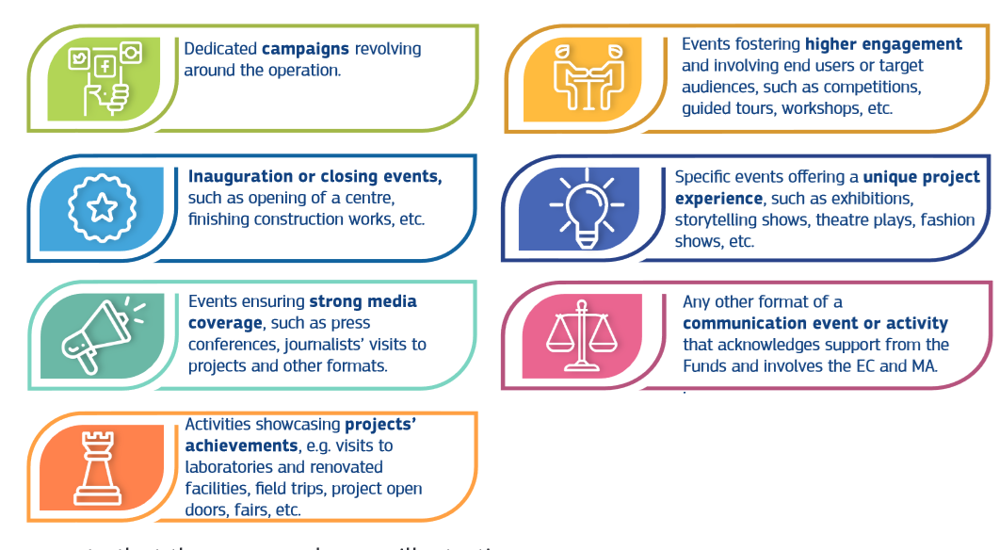
Eligibility of costs/expenditures (II)
Important! Don’t forget to budget for a communication event, as required for operations of strategic importance by Article 50(1)(e)of the CPR, involving the Commission and the Managing Authority, under the “External expertise and services” costs.
Please note that these examples are illustrative.

Slide 13
Eligibility of costs / expenditures (IIl)
interest on debt;
NON-ELIGIBLE costs/ expenditures
the purchase of land for an amount exceeding 10% of the total eligible expenditure for the operation concerned; for derelict sites and for those formerly in industrial use which comprise buildings, that limit shall be increased to 15 %. This provision shall not apply to operations concerning environmental conservation (criteria 12 – administrative and eligibility check);
value added tax (‘VAT’), except: (i) for operations the total cost of which is below EUR 5 000 000 (including VAT)*; (ii) for operations the total cost of which is at least EUR 5 000 000 (including VAT) where it is non-recoverable under national VAT legislation
fines, financial penalties and expenditure on legal disputes and litigation;
costs of gifts ; or
costs related to fluctuation of foreign exchange rate.
*except when the related costs represent State aid under GBER, in which cases only non-recoverable VAT under national VAT legislation is eligible (Article 7(1) EU Reg. 651/2014

Slide 14
Eligibility of costs / expenditures (IV)
Investments in infrastructure and works shall:
have a public character / as a main rule be carried out on a real estate (land and/or building) owned by the state (national/regional/local level);
be necessary for project implementation;
be justified in the Interreg VI-A Romania–Hungary Programme cross-border context;
be maintained for as long as possible, but at least until the end of the sustainability period.

Slide 15
State aid approach
State aid incidence should be avoided whenever possible!
In this respect:
JS/IP supports the applicants in the self-assessment of state aid incidence and guides them on how to develop their activities in order to avoid state aid incidence (Annex C – Guidelines to avoid State Aid incidence)
Applicants submit Annex 2. State Aid Self-Assessment (in line with relevant section in Jems)
State aid expert will make recommendations to avoid the incidence (when analysing projects activities during contracting)
In case State Aid incidence cannot be avoided:
De minimis/General Block Exemption Regulation and/or as Services of General Economic Interest will be used
Annexes 3 and/or 4 to AG will be submitted

Slide 16
MANDATORY ANNEXES
STATE AID APPROACH – Chapter 1.5
To the Application Form - Chapter 3.2
Supporting documents for projects foreseeing infrastructure works - Annex B.

Slide 17
Documents for submitting an eligible application
PROJECT (LEAD) APPLICANT DECLARATION To be provided in EN language. | The relevant data included in Jems shall be in entire accordance with the one(s) indicated in Annex 1. The template provided by the Programme shall be used (i.e. it is not allowed to modify the texting/wording of the document in any way), with the official header of the applicant organisation inserted.
Copy of the establishing documents of the Applicants: Articles of Association, Statutes, Deed of foundation, establishing resolution law or equivalent documents according to the national legislation, etc. Additionally, establishing documents will be provided for the related branch / field office, etc., that will prove its existence and the relation with the headquarter. Exception: public institutions/authorities/ do NOT need to submit this document! To be provided in RO / HU language. | The copy of the original establishing documents (in RO/HU language) shall be submitted in its entirety (e.g. in some cases extracts or only parts of the documents have been submitted).
The official statement of the relevant decision-making body regarding the support of the project and the availability of the own contribution for the planned investment, during the implementation of the project (e.g. County Council Decision, Local Council Decision, Board of Directors Decision, authorised person etc.); To be provided in RO / HU language. | Please check which decision-making body has the power/right to decide on the submission of the application and the budget. The decision should include the approval to support the project AND the commitment of the own-contribution (specifying the percentage and/or the amount) !!! Please round-up the amounts specified, so that they cover any calculation differences automatically made by the Jems system

Slide 18
Documents for submitting an eligible application
The job descriptions for all positions included in the proposed management team AND/OR the Terms of references in case the management is externalized. To be provided in EN language. | Please indicate in the documents which exact position(s) you are referring to in accordance with the information embedded in the Application Form (i.e. it is difficult to recognise and specify the CVs without having any reference). If job descriptions are provided, they can be generic (not personalised for specific employees) !!! Generic job descriptions are preferred
State Aid Documents 5.1 Self-Assessment (Annex 2) 5.2 De Minimis Declaration (Annex 3) - if the case 5.3 GBER Declaration (Annex 4) – if the case | All applicants must submit the State Aid Self-assessment (Annex 2). However, if the outcome of the self-assessment is YES (there is risk of state aid incidence), then Annexe 3 and Annex 4 must also be filled-in and submitted. Same applies for any risk of state aid incidence identified in Jems, section B. Project Partners, sub-section State aid criteria self-check. The absence/presence of the state aid incident has no impact on the eligibility of the application. However, the intensity of the financing might be affected (Guide for Applicants, section 1.5 State Aid). !!! We strongly recommend the applicants read Annex C. Guidelines to avoid state aid incidence.
Commitment (e.g. letter, strategy, legislation) of the relevant authority/body (e.g., Local/county council) on the need for the investment covered by the technical plans / feasibility study to be financed from the programme, in case of projects involving exclusively the elaboration of technical plans/feasibility studies | !!! Only for projects involving exclusively the elaboration of technical plans/feasibility study.

Slide 19
Annex B - submission Supporting documents in case of projects with works components/activities
Document | Description | Availability
Title deeds issued by the Land Registry, not older than 30 calendar days , for each real estate (land and/or building) affected by the investment. In addition, for the applicants not owning the relevant piece of land/building, documents proving the rights to use the real estates affected by the works. | Copy of the valid relevant documents, such as title deed, contract, agreement, concerning the type of ownership and any other rights of the Applicants. The rightful owner of the land and/or building to be subject of the forseen investment shall sign a declaration stating that the land and / or building / item of infrastructure is free of any encumbrances, not the object of a pending litigation, not the object of a claim according to the relevant national legislation. In case the land and / or building is in concession/administration, etc., it must be proved that the duration of the concession/administration is based on a long term contract/enactment (i.e. min. 5 years from the 31st of December of the year in which the final payment is made to the LP) and that the owner of the real estate has given his written agreement (no standard format) that the applicant is free to perform the investment. In case of an appropriation procedure is needed, the document of launching the procedure shall be attached. | Ideally, on submission of the application. If justified, the documents will be accepted by contracting, at the latest!
For RO applicants: Feasibility study / DAIW (if applicable for RO applicants) | In case a study is required its content must cover all the works element(s) of the planned project concerned and it has to contain a cost-benefit analysis. The FS will respect the legal provisions, in terms of content and formal requirements. | On submission of the application

Slide 20
Annex B - submission Supporting documents in case of projects with works components/activities
Document | Description | Availability
For HU applicants: Construction technical plans (engineering plans, descriptions) / Építési engedélyezési dokumentáció (tervrajzok, műszaki leírás) OR equivalent? | Construction plans (engineering plans, descriptions) / Építési engedélyezési dokumentáció (tervrajzok, műszaki leírás) and technical description necessary for obtaining the building permit. The documents shall be provided in PDF format and in an engineering software compatible format (protected version)? OR equivalent? If the planned works activity does not require a building permit: technical description and diagrammatical plan and the general plan of each building site – one copy per plan. NOTE! Construction plans should be available also in printed version at the premises of the relevant Beneficiary. The English summary should give an overview of the technical content of the planned investment. | On submission
For HU applicants: Detailed cost estimation of works / Tételes költségbecslés | Detailed cost estimation (Tételes költségbecslés) /price quotation by type of work issued by a designer indicating unit prices and the costs of materials and works / Detailed price quotation issued by an actor of the market, indicating unit prices and the costs of materials and works. The document should include who made it and when (name of issuer, signature, stamp, date of issuing) in PDF format (not in an Excel file). | On submission

Slide 21
Annex B - submission Supporting documents in case of projects with works components/activities
Document | Description | Availability
For HU applicants: Photo documentation / Fotó dokumentáció | Photos taken from the scene of the works activities (taken from all corners for each item for which land or building registration certificates are submitted) in its current state – in separate folders in JPG or PDF format. | On submission
Bilateral agreement of the Member States | Required in case of cross-border infrastructure (other than roads) | On submission

Slide 22
Annex B - contracting Supporting documents in case of projects with works components/activities
Document | Description | Availability
Technical Plans and Building/Construction permit (if already obtained) OR Documents certifying the exemption of the construction from building permit Építési engedélyezési tervek és építési engedély (amennyiben már rendelkezésre áll) VAGY Építési engedély nélkül végezhető építési tevékenységet igazoló dokumentum | Technical Plans and Building/Construction permit (if already obtained), OR Declaration certifying the exemption of the construction from building permit issued by the designer or the respective authority. | On contracting
Environmental permits and environmental impact assessment / Documents certifying the exemption from environmental assessment / attainment of environmental permit Környezetvédelmi engedélyek és környezeti hatástanulmány / Környezeti hatástanulmány / környezetvédelmi engedély nélkül végezhető tevékenységet igazoló dokumentum. | Environmental permits and environmental impact assessment (if already obtained) OR a Declaration of the relevant authority that conducting an environmental assessment or the attainment of environmental permit is not relevant for the project | On contracting

Slide 23
Documents for Contracting
In case these documents were submitted with the Application Form and haven’t been modified since the submission date,, the relevant partners shall sign a Declaration on their own responsibility regarding unmodified documents, on the template provided with the present notification, and the LP shall upload these declarations to Jems, in 5 working days from the notification date.
1 Establishing documents
a) For all Romanian partners (including associated organizations): justifying document stating the method of representation (according to the national legislation);
b) For all Hungarian partners (including associated organizations): original specimen of signature containing the method of representation of the legally authorized representative(s) of the applicant organizations/institutions, certified by a public notary.
For all Hungarian private partners: relevant sections of the establishing documents (or equivalent documents according to national legislation) reflecting the method of representation and stating the area of expertise in the field/fields the project addresses.
2 Official records
a) Criminal record for the legal representative (valid at the date of uploading in the Jems), for all Romanian partners;
b) Fiscal certificate regarding the fulfillment of the obligations related to the payment of debts to the consolidated state budget (valid at the date of uploading in the Jems), for all partners.
Please be advised that Hungarian Partners can obtain the document from the National Tax Authority respecting the provisions of Act XCII of 2003 on the rules of taxation. Legal entities admitted based on section 36/B. of the Act on the rules of taxation into the register of taxpayers free of tax debt will justify their compliance regarding state budget debts through the online public register of the National Tax Authority. The public debt status of a Hungarian entity can be verified online at http://nav.gov.hu/adatbazisok/koztartozasmentes/egyszeru_lekerdezes - (authentic and public database).

Slide 24
Documents for Contracting
c) Fiscal certificate regarding local taxes (valid at the date of uploading in the Jems), only for Romanian Partners.
For Hungarian Partners, the information regarding the fulfillment of the obligations related to the payment of debts to the local taxes is included in the document from the National Tax Authority respecting the provisions of Act XCII of 2003 on the rules of taxation.
d) Certificate from the district court attesting that the organization is not in the dissolution process (for associations, NGOs only)
Please be advised that Hungarian Partners can download/print the proof from the official online register http://birosag.hu/allampolgaroknak/civil-szervezetek/civil-szervezetek-nevjegyzeke-kereses, or equivalent proof in case of Churches, in line with AG, for all partners;
3 Property rights
Valid up-to-date official documents stating the right of property (e.g. ownership or long-term permission to use or to operate), for all partners, if the case.
4 Supporting documents
a) Decisions of the empowered bodies (County Council, Board of directors, etc.) regarding the support of the project and the availability of own resources and assuming the positions in the project implementation team (if applicable), for all partners, if modified after submitting the application;
b) Project justification sheet (Fișă de fundamentare a proiectului - Annex to Order No. 455/1267/2023 approving the Methodological Norms for applying the Law no. 231/2022) in case of Romanian partners.

Slide 25
III. Document/declaration TEMPLATES
a) Legal Entity Form filled in and signed by all partners, according to the type of the organization;
b) Declaration on own responsibility during the contracting phase regarding double financing, for all partners;
c) The partnership agreement signed by all partners.
d) Declaration on own responsibility during the contracting phase of the Lead partner certifying that the documents uploaded in the Jems are scanned copies of the originals, only if the documents are not electronically signed.
e) Application form dated and signed by the legal representative of the Lead partner (to be downloaded from Jems, after the application status in Jems is updated to “Approved”)
IV. Special requirements
JS/MA may request additional documents as compared to the ones mentioned above.
Hungarian partners shall provide the English/Romanian translation of the requested documents.
The Partnership Agreement and the updated Application form will only be submitted in Jems after the Application form is modified according to recommendations and/or conditions for financing, if any. Modifications in the Application Form and Partnership Agreement may also occur upon the finalization of the ongoing state-aid verification. In this case, you will be notified and kindly asked to resubmit the documents modified accordingly.
All documents will be uploaded in the “Shared folder” section of the Jems. In order to be identified and verified in the system, each document will be named in accordance with the relevant content.
The documents will be presented at the contracting or first monitoring visit in original/legalized copy/certified copy according to original and JS/IP/MA experts may request such documents to attach them to the project dossier.
The documents specified within point III. Document/declaration templates will be downloaded from the Programme’s website – Contracting templates: https://interreg-rohu.eu/en/project-documents/

Slide 26
Public consultation outcome
Bekes County Council proposed the adjustment of Annex B as follows:
Instead of "construction technical plans" on submission, brief technical description and a schematic drawing should be needed
Instead of "technical plans and building/construction permit" on contracting, we propose contracting with a suspensive clause (building permit required later according to the relevant legislation)
The Ministry of Internal Affairs in Romania proposed the adjustment of the Assessment and selection methodology, regarding the reconciliation procedure, through the modification of the following paragraph in Section 2.1. Quality Assessment:
"In the context of the quality assessment, a reconciliation is required. The Chair of the AWG shall organize a reconciliation meeting with both evaluators in the following situations:
a. One evaluator awards the Application a total score above the threshold (70 for OSIs), but the other evaluator awards a score below it, if the average score is below 70;
b. The difference between the total scores awarded for an Application by the two evaluators is more than 10 points;
The reconciliation will be arbitrated by the Chair and proceed as a free discussion. The Chair will present in detail the Quality Assessment Criteria and each evaluator will provide reasoning for their assessment. If the discrepancies specified above remain unresolved after reconciliation, a re-assessment will be conducted by two additional evaluators appointed by the Management Authority. It is important to note that in the event of a re-assessment, the final score will be the average of the two new scores awarded."
Notes:
Following the public consultation of the 2 proposals were received

Slide 27
MC DECISION
MC approves the Targeted Call for the Operations of Strategic Importance listed in Appendix 3 to the Interreg Programme, to be launched on November 9th, 2024, with submission deadline on December 2nd, 2024, also approving the exceptional procedural framework and the calendar for assessment and contracting in parallel. The MC also agrees to have an online selection meeting, without observing the deadlines regulated by RoP’s Rule 5(3) for convening MC meetings. This MC decision will annul the MC Decision 3/ 19.12.2023.
MC approves the Applicants Guide package and the eligibility, quality and selection criteria for the OSIs, as provided in Annex 2 to this Decision.
MC approves that OSIs selected for financing will be granted weighted funding of minimum 82% of the requested ERDF, calculated based on the maximum eligible value of the ERDF, as provided by the targeted call for proposal; specifically, 8,750,000 ERDF for OSIs under P1 and P2 and 3,500,000 ERDF for OSIs under P3. Final percentage of the weighted funding will be determined by the values of the final budgets of all OSIs submitted by December the 2nd, 2024, meeting all criteria for financing.
MC approves the exception to the eligibility / contracting rules of the targeted call, as follows:
A Subsidy Contract may be concluded even for projects NOT submitting mandatory documents on contracting, subject to the following resolutive clause: Lead Partner shall submit until 31 March 2025 all the mandatory annexes (documents and/or conditions to be listed here), in the format requested by the Programme rules within the Applicant’s Guide…. In the event that the Lead Partner fails to provide the requested documents in accordance with the conditions set by the Programme, the MA and NA are entitled to terminate the contract, respectively the co-financing contracts, and recover the full amounts of the financing already paid.

Slide 28
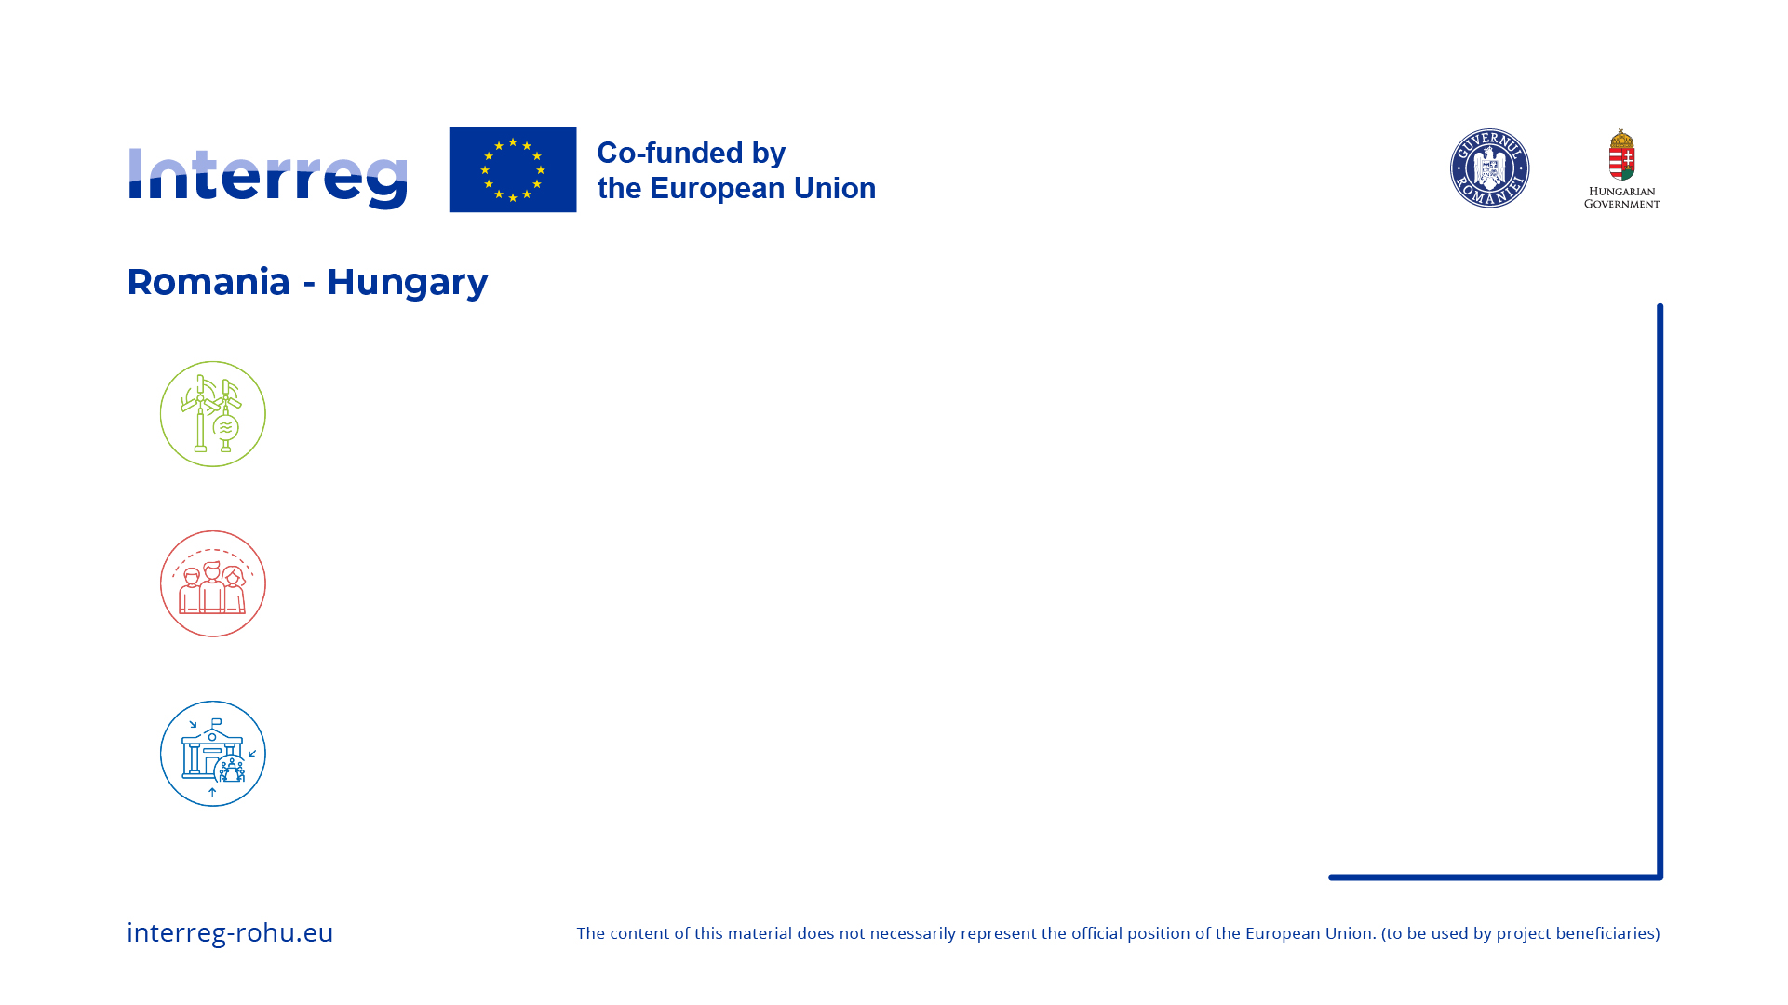
Thank you!
Phone: +40-259-473.174
E-mail: joint.secretariat@brecoradea.ro

